Slide 1
ATREZZO CONNECT
PROVIDER PORTAL REGISTRATION
SCDHHS

Slide 2




KEPRO Introduction
Since 1985, KEPRO has helped members lead healthier lives through clinical expertise, integrity and compassion. KEPRO was founded by physicians and clinical expertise
is at the core of our organization.
Currently servicing 250 commercial, public and
federal clients
URAC accredited in UM, CM, DM, pursuing IRO accreditation in 2019
15 offices and more than 1,400 employees
More than 3,000 credentialed physicians and 500 clinicians on our Advisory and Review panel

Slide 3
Strengthening health status through quality and clinical expertise
KEPRO offers a platform of capabilities for complex populations with clinically-driven, technology-enabled services that meet the needs of our government client markets.
Care Management | Quality Management | Assessments & Clinical Eligibility | Administrative Services
Utilization Management Case Management Pharmacy Management Care Coordination EAP & Absence Management | Appeals & Grievances External Quality Review Healthcare Effectiveness Data and Information Set (HEDIS) Standard of Care Reviews | Levels of Care Assessment Health Risk Assessments Preadmission Screening & Resident Review (PASRR) Behavioral Health Needs Assessment | Application Processing Center Payment Integrity Claims Adjudication Network Management Provider Credentialing and Training
15+ year
Average Customer Relationship Length

Experienced with the customization needed for health plans

Slide 4

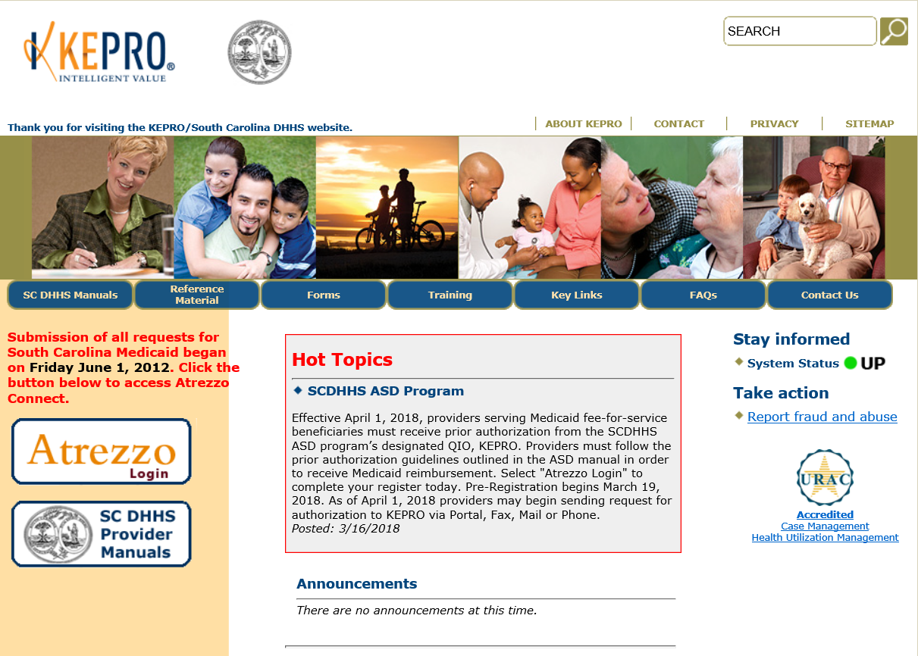
TO REGISTER FOR ATREZZO CONNECT
WEBSITE ADDRESS:
https://scdhhs.kepro.com
SELECT REGISTRATION
ENTER 10 DIGIT NPI NUMBER
ENTER 6 DIGIT SC MEDICAID PROVIDER ID (Legacy)
SELECT UNIQUE USERNAME/ PASSWORD
COMPLETE REQUIRED USER INFORMATION

Slide 5

Atrezzo connect Provider Portal
Advantages of Provider Portal:
  ACCOUNT ADMINISTRATOR
Secured access to Provider Portal
Access letters via Case/ Request
Respond/ Send messages To/From KePRO
Track case status & upload clinical documentation.
The individual completing the initial registration will present as the PORTAL GROUP Admin.
GROUP ADMIN is responsible for managing and creating ALL submitting user accounts for your NPI #
Removing Admins and User Accounts
      Set Preferences, i.e. Diagnosis & Procedure codes
      Reset Passwords
Notes:
**For security purposes, the provider must verify the 6 digit SCDHHS Medicaid ID Legacy Number.

Slide 6

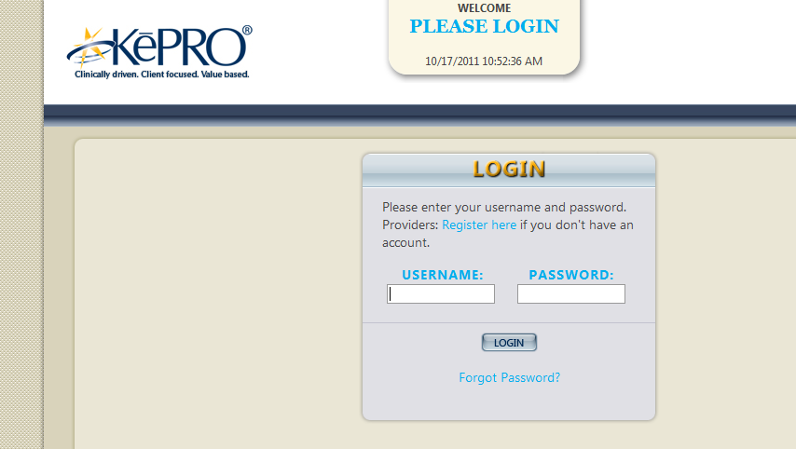
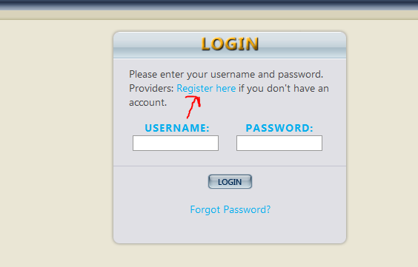
Registration process
From the KePRO-SCDHHS website
www.scdhhs.kepro.com
Start by CLICKING THE ATREZZO LOGIN
You will then be taken to the Login Page
CLICK the Register Here link to Register a new account

Slide 7
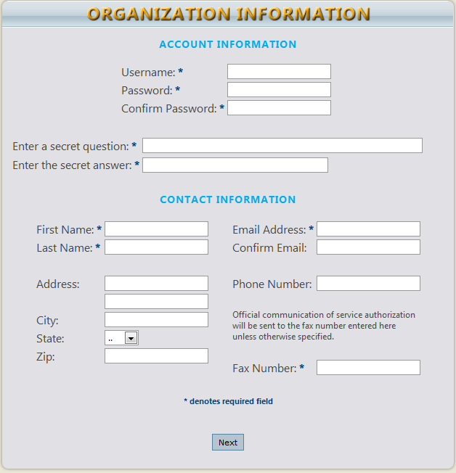
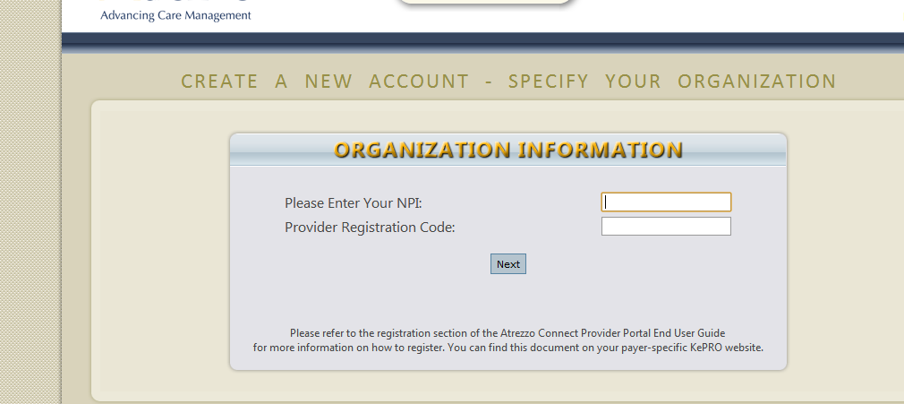
Registration process cont
ENTER NPI AND LEGACY ID
ENTER ACCOUNT INFORMATION
Enter organization’s NPI and 6 digit SCDHHS Medicaid ID number (Provider Registration Code)
Click NEXT
Minimum 8 character password that
Passwords/accounts are deactivated after 30 days of non-usage
Complete the password recovery.
User Name, Password, First/Last Name, Email and Fax Number are all REQUIRED fields.

Slide 8
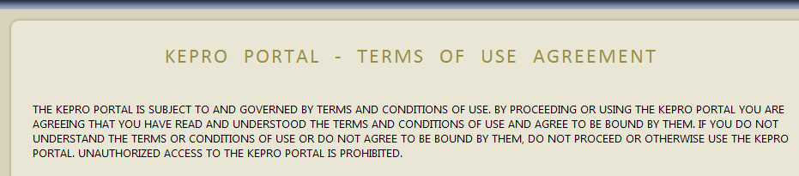
Registration process cont
VERIFY ADDRESS
REVIEW & ACCEPT TERMS OF AGREEMENT
Selecting the correct address will associate your user information with the correct location
Their can be multiple provider types/ locations. Selecting the correct type/ location yields best results.
If all apply. Check all of them.
Click SELECT
You’ll then be taken to the Atrezzo Connect Home Page

Slide 9
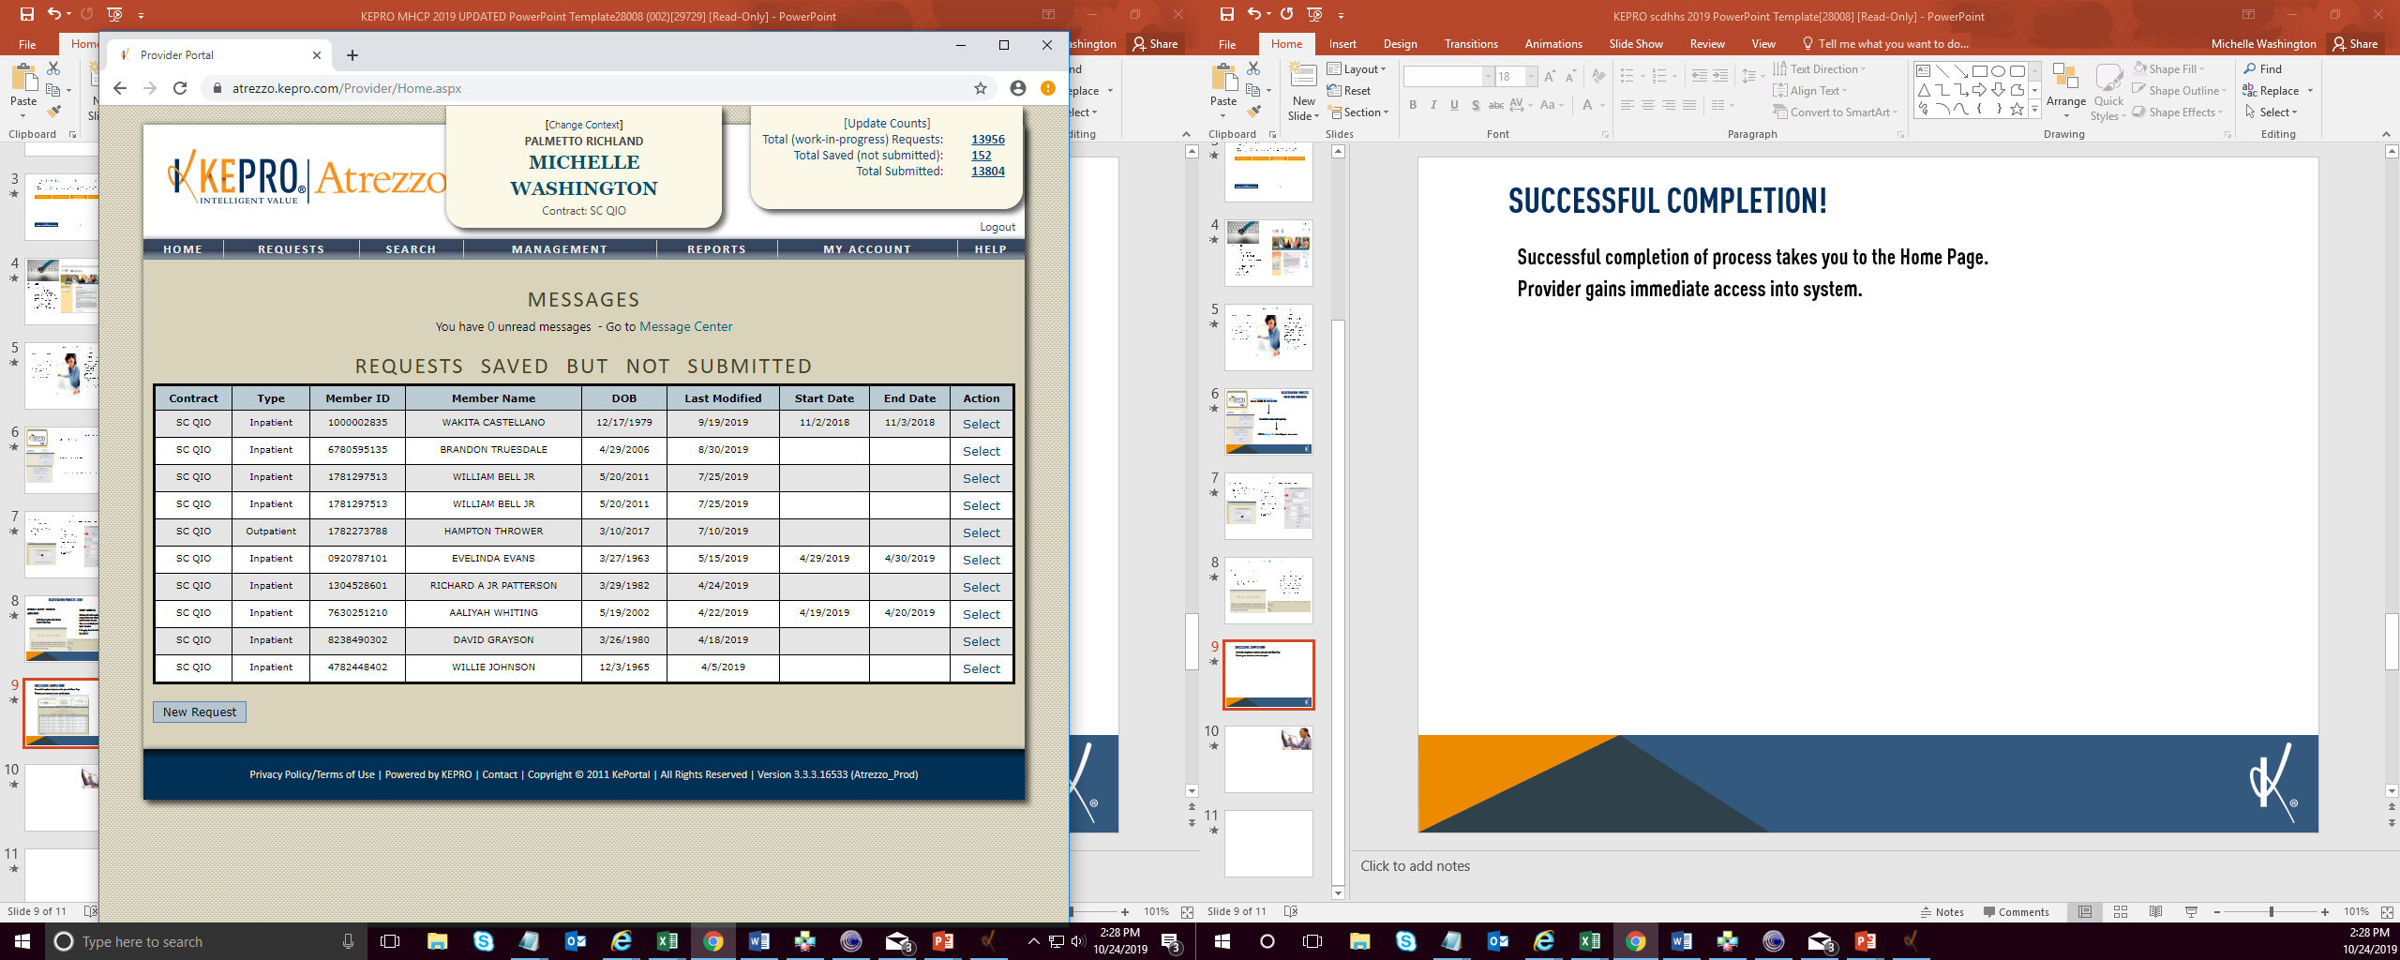
Registration COMPLETE!!!
Successful completion of the registration process takes you to the Atrezzo Home Page.
Provider gains immediate access into system.

Slide 10

KePRO Website: https://scdhhs.kepro.com
For questions call:
1-855-326-5219 or email atrezzoissues@kepro.com

Slide 11
Thank you

