Slide 1


ATREZZO PROVIDER PORTAL: INPATIENT CASE CREATION

Slide 2
ACCESSING ATREZZO PROVIDER PORTAL
Website Address: https://scdhhs.kepro.com
Select ‘’Atrezzo Login’’
To Register for Atrezzo Provider Portal:
Enter your 10 digit National Provider Identifier (NPI) number and Provider Registration Code. For additional assistance contact KEPRO Customer Service at 1-855-326-5219.
Registered Provider- Enter your unique username and password
**If you have multiple NPI numbers, you must register those NPI numbers under your administrative account in Atrezzo Connect.**

Slide 3
Inpatient Case Creation
Upon completion of registration/login, the Home Page will then display. Click New Request to initiate a case.

Slide 4
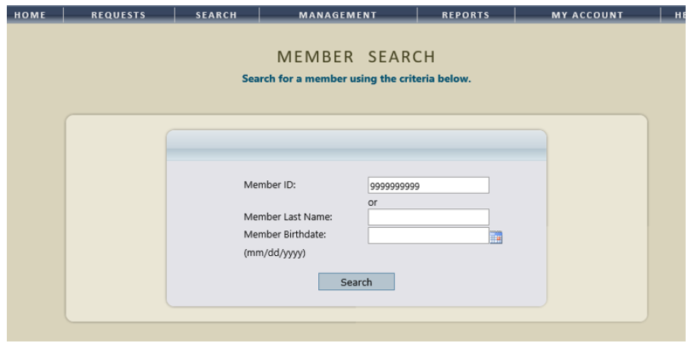
Inpatient Case Creation (cont’d)
A Member Search can be performed by either entering in the Members ID number or the Members Last Name and Date of Birth. (PLEASE NOTE: Entering information in all three search fields will NOT yield results. You must either search by the Members ID number or their demographic information.)

Slide 5
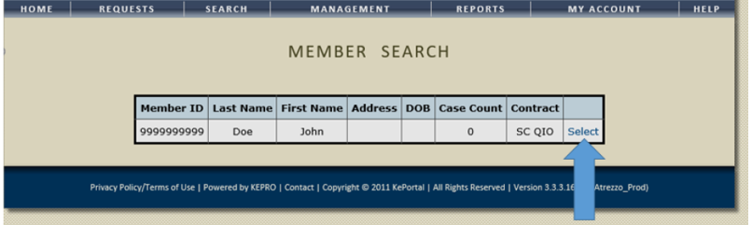
Inpatient Case Creation (cont’d)
Select the Member from the search results by clicking Select. (Ensure the accuracy of the members name and member ID before proceeding.)

Slide 6
Inpatient Case Creation (cont’d)
Verify the member’s information then click New Request.

Slide 7
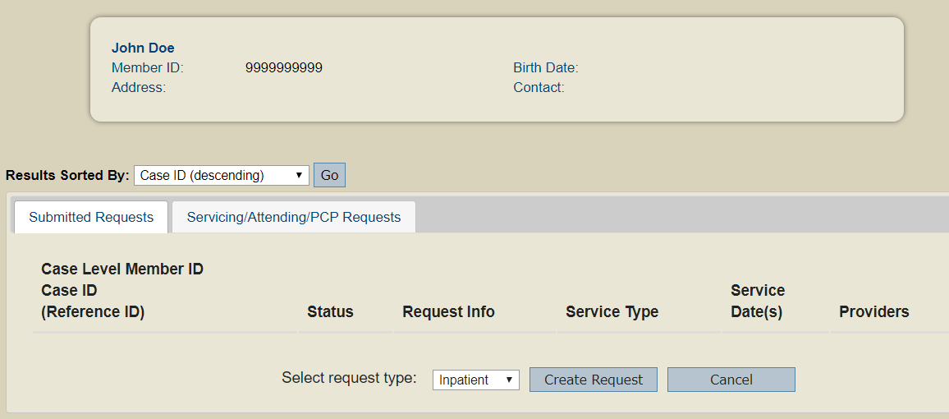
Inpatient Case Creation (cont’d)
Select Inpatient as the request type and click Create Request.

Slide 8
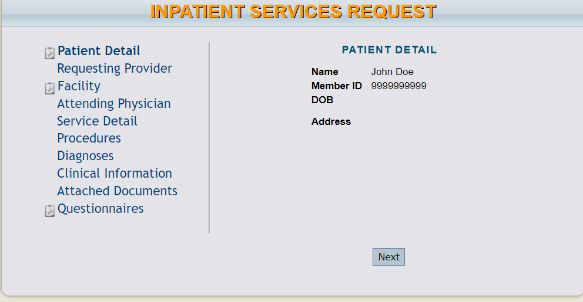
Inpatient Case Creation (cont’d)
The first section will be the Patient Detail. To continue click the NEXT button.

Slide 9
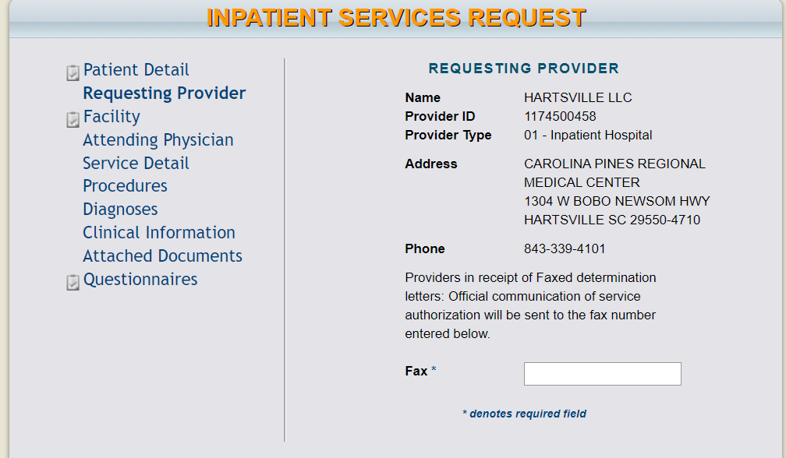
Inpatient Case Creation (cont’d)
The Requesting Provider section will populate the requesting provider listed in the change context Section. If requesting provider need to be changed, you must cancel request, make the selection from the change context section, then proceed with new case creation. Enter in the FAX number to where the correspondence pertaining to this request should be sent. (NOTE: The Requesting Provider can only be changed if there is more than one NPI number registered to the Atrezzo Provider Portal account. If the requesting provider is not correct, you must cancel the request, change context and start with new case creation.)

Slide 10
Inpatient Case Creation (cont’d)
The Facility section will display the populated provider from the requesting provider section. To change this information, click the Find button to perform a provider search.

Slide 11
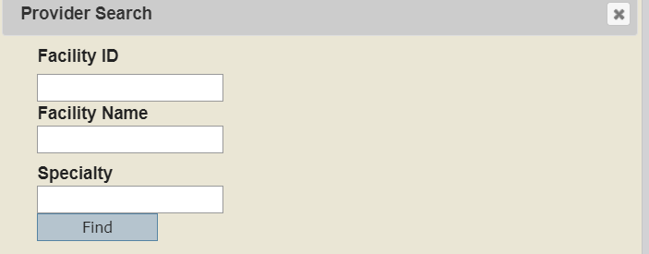
Inpatient Case Creation (cont’d)
You can search for the Facility by entering either the Facility ID (NPI number) or Facility Name and click Find.

Slide 12
Inpatient Case Creation (cont’d)
The Attending Physician section is OPTIONAL. Use the Find button to search for the attending physician to be added.

Slide 13
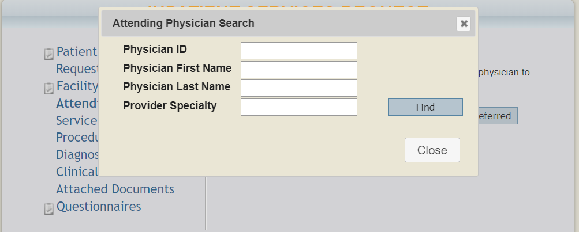
Inpatient Case Creation (cont’d)
You can search for the physician by entering either the Physician ID (NPI number), the Physicians First or Last Name, or the Provider Specialty, then click Find.

Slide 14
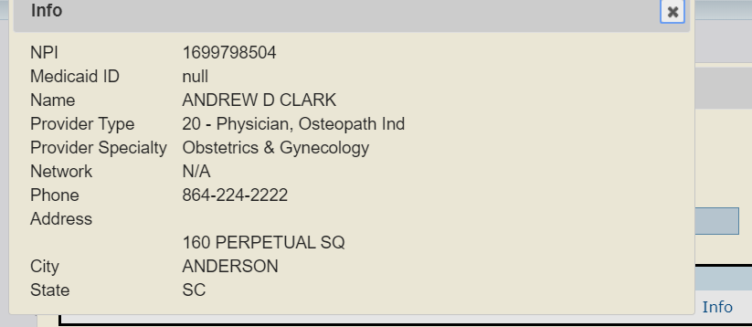
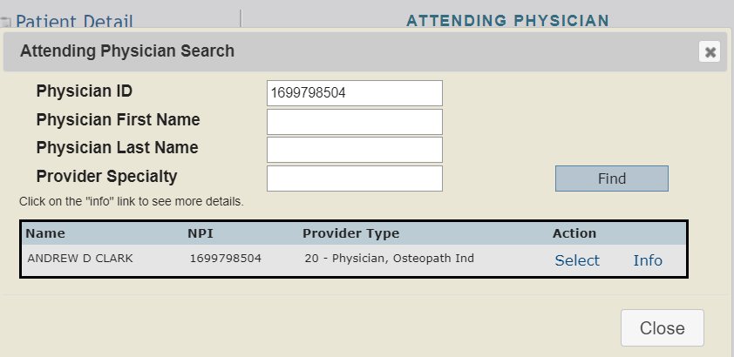
Inpatient Case Creation (cont’d)
The physicians information will then display. To see more detailed information about the physician click Info. To add the physician to the request click Select.

Slide 15
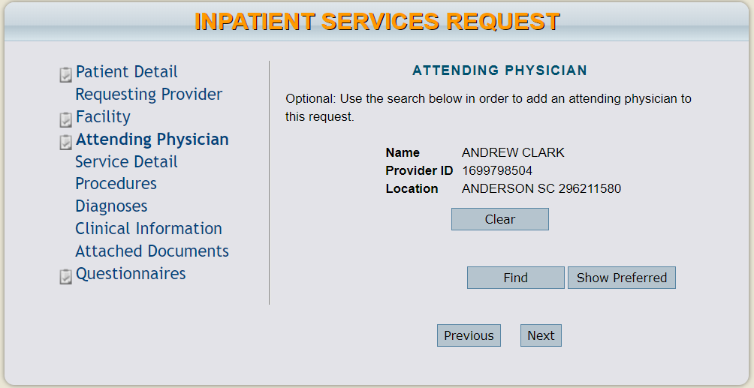
Inpatient Case Creation (cont’d)
The Attending Physician has now been added the request. (To select a different the physician, click Clear, and then Find to search for the physician)

Slide 16
Inpatient Case Creation (cont’d)
In the Service Detail section select the applicable Service Type, Admission Source, and Request Type from the drop down menu. In Length of Stay section, if the request is Inpatient Acute, always enter 1 day. Select the admit date from he drop down calendar in the Admit Date section. The Start Date/End Date will populate based on the admission date and the length of stay. (PLEASE NOTE: The Rate and the FIPS section are to be left BLANK)

Slide 17
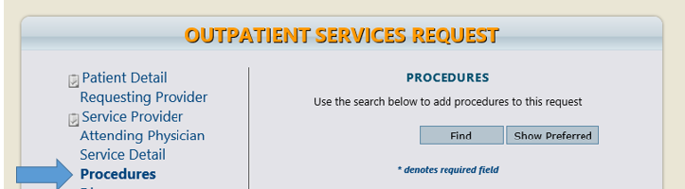
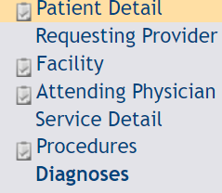

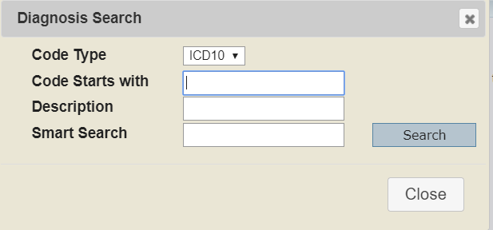
Inpatient Case Creation (cont’d)
In the Diagnosis section, click Find to select the diagnosis for this request. Enter the Code or the Description and click Search.

Slide 18
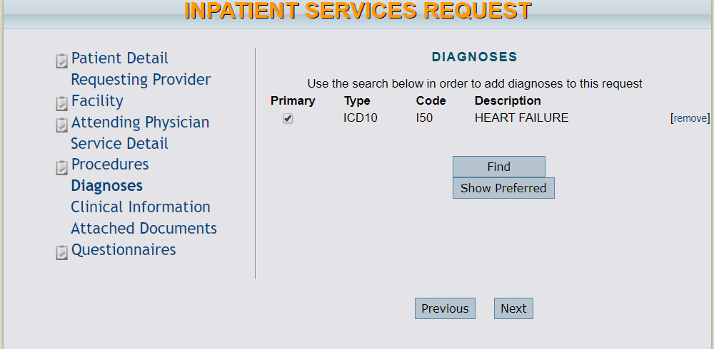
Inpatient Case Creation (cont’d)
A diagnosis code must be selected for the request. If there is multiple diagnosis codes, one must be selected as Primary. The codes cannot be changed once a case has been submitted.

Slide 19
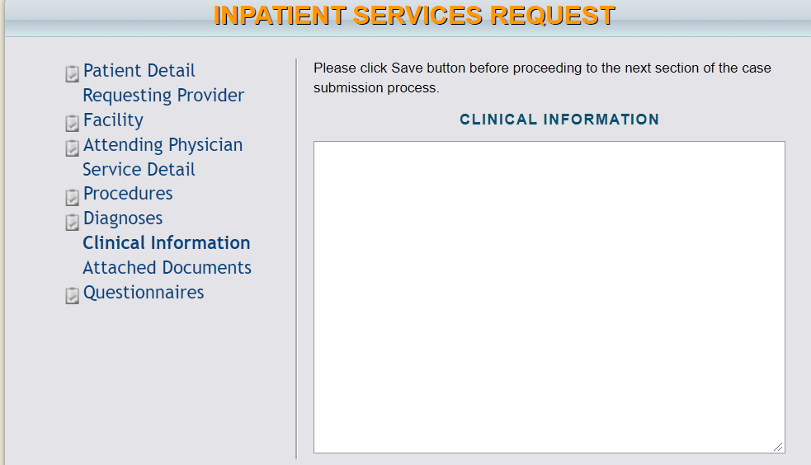
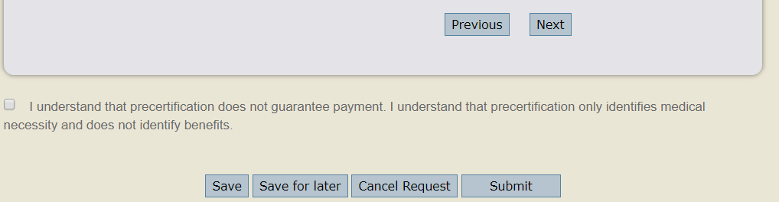
Inpatient Case Creation (cont’d)
In the Clinical Information section you can type or copy/paste clinical notes pertaining to the request. (PLEASE NOTE: Click the Save button before moving on to the next section).

Slide 20
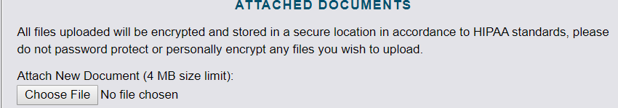
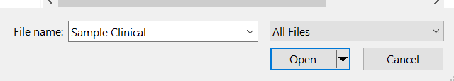
Inpatient Case Creation (cont’d)
The Attached Documents section allows you to upload clinical documentation that has been saved to your computer. To attach documents, click on the Choose File button. Then select the document you want to upload and click Open.

Slide 21
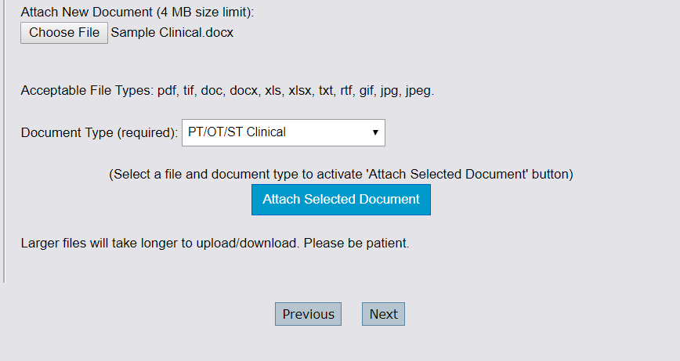
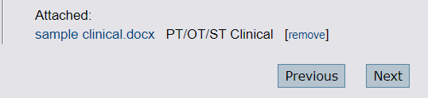
Inpatient Case Creation (cont’d)
The name of document that you uploaded will appear next to the Choose File button. You must then select a Document Type that describes the type of clinical information you attached. Once a document type is selected, the Attach Selected Document button will turn blue. Click the Attach Selected Document button to successfully attach the document.

Slide 22
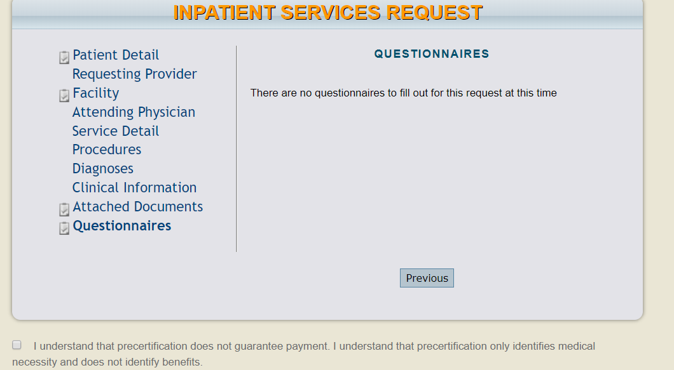
Inpatient Case Creation (cont’d)
All required questionnaire names will be displayed as a hyperlink. Click the on Questionnaires Name to open and complete.
See Atrezzo Provider Portal Questionnaire Training for additional details

Slide 23
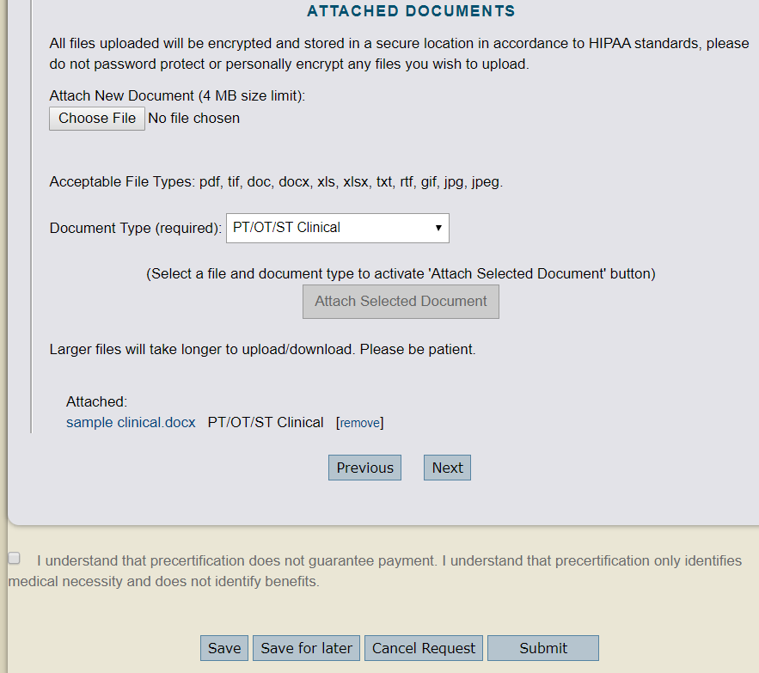
Inpatient Case Creation (cont’d)
The request is now ready for submittal. Make sure to check the box at the bottom of the page to acknowledge the precertification statement. Select the Save for Later button to save the request to submit at a later time (the request will display under the Saved But Not Submitted section on the Home page). The Cancel button will cancel out the entire request. Click Submit if you are ready to submit the request.

Slide 24
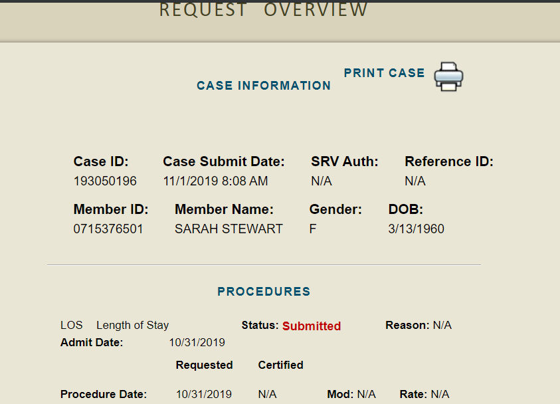
Inpatient Case Creation (cont’d)
Once the case has been submitted, the Request Overview page will display. (PLEASE NOTE: The case is not received by KEPRO until the Case ID is displayed under the Case Information section.) The request will also show the Status: Submitted under the procedures section.

Slide 25
For additional training documents, please refer to the Atrezzo Portal User Guide located under the HELP tab within your Atrezzo Provider Portal account.

