Slide 1
Cultural Awareness Training
Transportation Providers 2021

Slide 2
This course will provide information on
Your role in cultural awareness
Communication/Language Assistance
Cross-cultural communication
Impacts of cultural influences
Health and social disparities
Notes:
Presenter
2021-04-28 14:45:05
--------------------------------------------
This course will provide information on: Your role in cultural awareness Communication
Language assistance Impacts of cultural influences Health and social disparities Cross-cultural communication

Slide 3
Culture
Culture refers to integrated patterns of human behavior that include the language, thoughts, actions, customs, beliefs, values, and institutions that unite a group of people.
Members’ respective cultures affect every aspect of their care, including the transportation to their medical appointments that you provide.

Slide 4
Cultural Competency
Cultural Competence is the awareness and understanding of people from one or more different cultures, as well as the ability to effectively interact with them.

Slide 5
Diversity
Diversity consists of the differences we recognize in each other such as gender, culture, race, ethnicity, age, religion, sexual orientation, and physical and mental abilities. Diversity also includes other factors such as economic status, point of view, educational background, employment history and political beliefs. As our economy becomes increasingly global, our community grows ever more diverse!
Notes:
Presenter
2021-04-28 14:45:06
--------------------------------------------
Diversity consists of the differences we recognize in each other such as gender, culture, race, ethnicity, age, religion, sexual orientation, and physical and mental abilities. Diversity also includes other factors such as economic status, point of view, educational background, employment history and political beliefs. As our economy becomes increasingly global, our community grows ever more diverse!

Slide 6
Diversity in Business
Socio- economic Status
Sexual Orientation
Gender Expression & Identity
Age
Gender
Race
Religion
Language
Notes:
Presenter
2021-04-28 14:45:07
--------------------------------------------
As a Transportation Provider, you encounter members who are influenced by a wide variety of cultural factors, such as: Age
Gender Race Religion
Socio-economic status Language
Sexual orientation
Gender expression and identity

Slide 7
Diversity in Business
Promoting diversity is a critical part of ModivCare’s commitment to providing superior customer service to our members.
Member satisfaction is enhanced
Members who receive a positive response to their own cultural or linguistic background will be encouraged to use ModivCare continuously for their non- emergency medical transport
Positive attitudes are win-win
We need to be able to meet, greet, transport and work alongside diverse individuals
Notes:
Presenter
2021-04-28 14:45:07
--------------------------------------------
Promoting diversity is a critical part of ModivCare’s commitment to providing superior customer service to our members. Member satisfaction is enhanced
Members who receive a positive response to their own cultural or linguistic background will be encouraged to use ModivCare continuously for their non-emergency medical transport Positive attitudes are win-win
We need to be able to meet, greet, transport and work alongside diverse individuals

Slide 8
Race, Culture and Language
Racial, cultural and linguistic prejudices can inflict deeply hurtful insults. When you disparage someone in any of these ways, you're insulting not only the individual but also the person's family, friends, ancestors and heritage.
This can also feel very threatening — especially if the targeted individual is of a small minority in the workplace.
Notes:
Presenter
2021-04-28 14:45:07
--------------------------------------------
Racial, cultural and linguistic prejudices can inflict deeply hurtful insults. When you disparage someone in any of these ways, you're insulting not only the individual but also the person's family, friends, ancestors and heritage. This can also feel very threatening — especially if the targeted individual is of a small minority in the workplace.

Slide 9
Race, Culture and Language
It's okay, and often even beneficial, to acknowledge stereotypes. Awareness of one's stereotypes makes them easier to deal with and helps avoid mistakes that can lead to offensive comments or actions.
Notes:
Presenter
2021-04-28 14:45:07
--------------------------------------------
It's okay, and often even beneficial, to acknowledge stereotypes. Awareness of one's stereotypes makes them easier to deal with and helps avoid mistakes that can lead to offensive comments or actions.

Slide 10
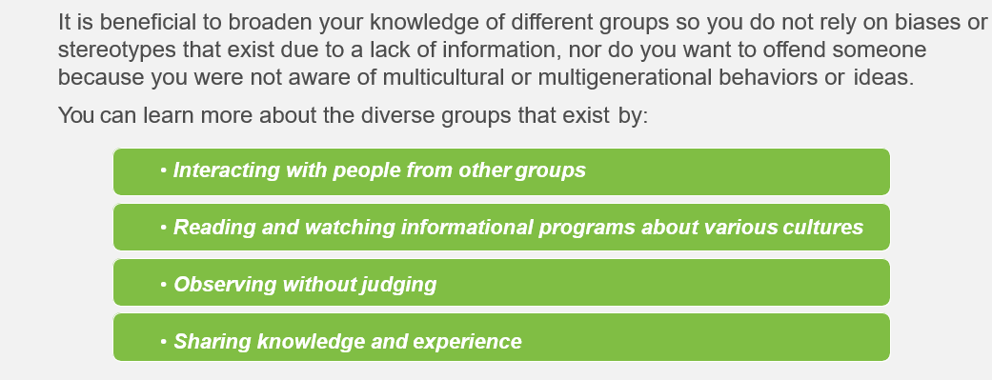
Race, Culture and Language
Notes:
Presenter
2021-04-28 14:45:07
--------------------------------------------
It is beneficial to broaden your knowledge of different groups so you do not rely on biases or stereotypes that exist due to a lack of information, nor do you want to offend someone because you were not aware of multicultural or multigenerational behaviors or ideas. You can learn more about the diverse groups that exist by:
• Interacting with people from other groups
• Reading and watching informational programs about various cultures
• Observing without judging
• Sharing knowledge and experience

Slide 11
Your Role in Cultural Awareness

Slide 12
Your Role in Diversity
Different people require different approaches to achieve positive outcomes due to their unique health and home challenges.
The transportation you provide to members from diverse cultural backgrounds helps ensure they have meaningful access to health care and social services.
Your awareness and understanding of cultural diversity helps you better provide this meaningful access to sometimes vulnerable and fragile members.
Notes:
Presenter
2021-04-28 14:45:07
--------------------------------------------
Different people require different approaches to achieve positive outcomes due to their unique health and home challenges.
The transportation you provide to membersfrom diverse cultural backgrounds helps ensure they have meaningful access to health care and social services. Your awareness and understanding of cultural diversity helps you better provide this meaningful access to sometimes vulnerable and fragile members.

Slide 13
Bulletin – Advantages of Diversity
Advantage One
Seeing an issue from multiple points of view can help you make better decisions.
Advantage Two
Creativity increases when people with different backgrounds come together to solve problems or develop new business initiatives.
Notes:
Presenter
2021-04-28 14:45:08
--------------------------------------------
Advantage One - Seeing an issue from multiple points of view can help you make better decisions.
Advantage Two - Creativity increases when people with different backgrounds come together to solve problems or develop new business initiatives.

Slide 14
Communication

Slide 15
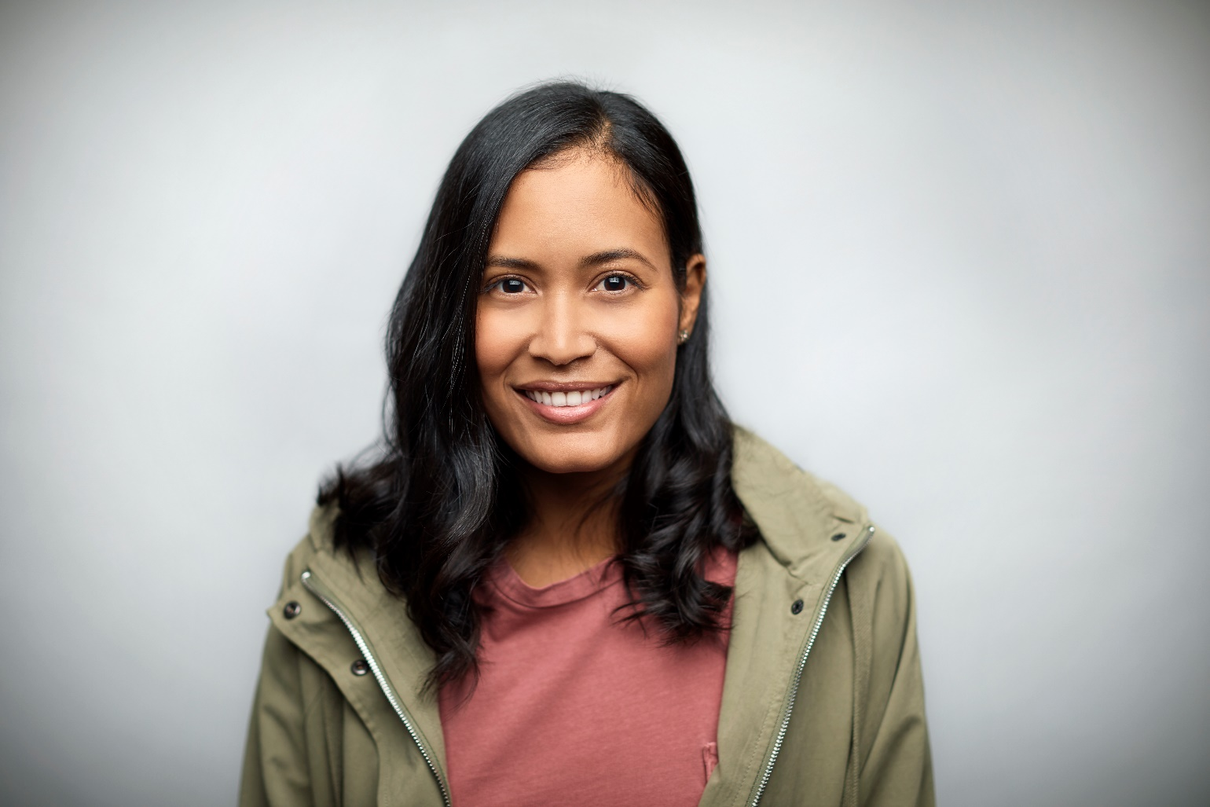
Communication
Clear communication is central to developing cultural competency as some members have limited English proficiency (LEP).
LEP describes a member who has an inability or limited ability to speak, read, write or understand the English language on a level that permits him/her to interact effectively with others, including Transportation Providers and Healthcare Providers.
Notes:
Presenter
2021-04-28 14:45:08
--------------------------------------------
Clear communication is central to developingcultural competency as some members have limited English proficiency (LEP).
LEP describes a member who has an inability or limited ability to speak, read, write or understand the English language on a level that permits him/her to interact effectively with others including Transportation Providers and Healthcare Providers.

Slide 16
Limited English Proficiency Statistics
20%
17%
20% of the people living in the U.S. speak a language other than English in their home.
The Hispanic population grew by forty-three percent in the U.S. between 2000 and 2010.
17% of the foreign-born population in the
U.S. is classified as newly arrived (2005 or later).
One out of two adult patients has a hard time understanding basic health information due to a lower level of English proficiency.
Notes:
Presenter
2021-04-28 14:45:08
--------------------------------------------
20% of the people living in the U.S. speak a language other than English in their home. The Hispanic population grew by forty-three percent in the U.S. between 2000 and 2010. 17% of the foreign-born population in the U.S. is classified as newly arrived (2005 or later).
One out of two adult patients has ahard time understanding basic health information due to a lower level of English proficiency.

Slide 17
Communication & Respect
Communication and respect are key to creating an inclusive and diverse atmosphere. Consider these basic rules of communication:
Avoid offensive language, such as racial or gender epithets. Before using a questionable term or phrase, ask yourself “How would I feel if someone said this to me?”
Avoid offensive jokes that make fun of others. This can be construed as harassment.
Make it clear that you won’t tolerate offensive speech or behavior from others.
Treat people as individuals with unique beliefs, opinions and styles.
Be aware of how your own cultural assumptions may cause you to misunderstand another person.
Address others in a way that shows you respect them.
Don’t assume that others will have similar values, standards, or backgrounds as you.
Notes:
Presenter
2021-04-28 14:45:08
--------------------------------------------
Communication and respect are key to creating an inclusive and diverse atmosphere. Consider these basic rules of communication:
Avoid offensive language, such as racial or gender epithets. Before using a questionable term or phrase, ask yourself “How would I feel if someone said this to me?” Avoid offensive jokes that make fun of others. This can be construed as harassment.
Make it clear that you won’t tolerate offensive speech or behavior from others. Treat people as individuals with unique beliefs, opinions and styles.
Be aware of how your own cultural assumptions may cause you to misunderstand another person. Address others in a way that shows you respect them.
Don’t assume that others will have similar values, standards, or backgrounds as you.

Slide 18
Language Assistance

Slide 19
Impacts of Cultural Influences
There are growing concerns over health issues that affect American society which can differ among ethnic groups. Each population has its own health issues: Anglo-, Asian-, African-, and Latino-Americans, as well as genders.
A subculture is an ethnic, regional, economic or social group exhibiting characteristic patterns of behavior sufficient to distinguish it from others within an embracing culture or society.
Disparities exist for a variety of reasons. Some of the members you transport may encounter barriers in the healthcare delivery system and variations in the medical care they receive.
Other members you transport may suffer from a higher prevalence of certain medical conditions and/or may be diagnosed at a later or more severe stage of disease.
Notes:
Presenter
2021-04-28 14:45:10
--------------------------------------------
There are growing concerns over healthissues that affect American society which can differ among ethnic groups. Each population has its own health issues: Anglo-, Asian-, African-, and Latino-Americans, as well as genders. A subculture is an ethnic, regional, economic or social group exhibiting characteristic patterns of behavior sufficient to distinguish it from others within an embracing culture or society.
Disparities exist for a variety of reasons. Some of the members you transport may encounter barriers in the healthcare delivery system and variations in the medical care they receive. Other members you transport may suffer from a higher prevalence of certain medical conditions and/or may be diagnosed at a later or more severe stage of disease.

Slide 20
Health & Social Disparities

Slide 21
Health & Social Disparities
Social determinants, such as economic and social conditions in particular communities, may also influence members’ health status and outcomes including:
Education
Income
Geography
Ethnicity
Sexual orientation
Disability
Gender identity and expression
Notes:
Presenter
2021-04-28 14:45:10
--------------------------------------------
African Americans experience disparities with chronic conditions, access to healthcare, and preventative screenings, including high rates than the general population of: Diabetes
Obesity
Heart disease
Breast and colon cancer High blood pressure Stroke

Slide 22
African American Health & Social Disparities
The underlying causes of African-Americans’ health disparities have been linked to genetics, lack of economic resources, limited access to health care, environmental factors, and delay in treatment.
These disparities can be mitigated by community outreach, diversity and inclusion activities, and clinical interventions.
Notes:
Presenter
2021-04-28 14:45:11
--------------------------------------------
The underlying causes of African-Americans’ health disparities have been linked to genetics, lack of economic resources, limited access to health care, environmental factors, and delay in treatment. These disparities can be mitigated by community outreach, diversity and inclusion activities, and clinical interventions.

Slide 23
Hispanic Health & Social Disparities
Health disparities affecting the Hispanic population when compared to non-Hispanic whites in the U.S. include:
30% less likely to obtain cancer screenings
50% more likely to die from diabetes
25% less likely to control high blood pressure
Less likely to receive mental health treatment or counseling
More likely to have asthma
Higher rates of obesity
More likely to suffer from untreated dental maladies
More likely to experience medical events involving risk of death or serious injury
Notes:
Presenter
2021-04-28 14:45:12
--------------------------------------------
Health disparities affecting the Hispanic population when compared to non-Hispanic whites in the U.S. include: 30% less likely to obtain cancer screenings
50% more likely to die from diabetes
25% less likely to control high blood pressure
Less likely to receive mental health treatment or counseling More likely to have asthma
Higher rates of obesity
More likely to suffer from untreated dental maladies
More likely to experience medical eventsinvolving risk of death or serious injury

Slide 24
Hispanic Health & Social Disparities
Social disparities affecting Hispanics include:
1 in 3 Hispanics do not graduate from high school
1 in 4 Hispanics live below the poverty line
1 in 3 Hispanics do not speak English well
The underlying causes of health disparities in the U.S. Hispanic community include:
Poverty
Inadequate access to health care
Education inequities
Language barriers
Environment factors
Notes:
Presenter
2021-04-28 14:45:12
--------------------------------------------
Social disparities affecting Hispanics include:
1 in 3 Hispanics do not graduate from high school 1 in 4 Hispanics live below the poverty line
1 in 3 Hispanics do not speak English well
The underlying causes of health disparities in the U.S. Hispanic community include: Poverty
Inadequate access to health care Education inequities
Language barriers Environment factors

Slide 25
Hispanic Health & Social Disparities
Activities that can reduce these disparities include:
Providing education in Spanish on the importance of preventative care and other health issues
Medical care providers enhance and expand language access services to increase “healthcare literacy”
Increase medical care providers’ understanding of the Hispanic population’s unique needs, cultures and experiences
Identify the diversity within the Hispanic population and understand and respect the differences between subgroups
Notes:
Presenter
2021-04-28 14:45:12
--------------------------------------------
Activities that can reduce these disparities include:
Providing education in Spanish on the importance of preventative care and other health issues
Medical care providers enhance and expand language access services to increase “healthcare literacy”
Increase medical care providers’ understandingof the Hispanic population’s unique needs, cultures and experiences Identify the diversity within the Hispanic population and understand and respect the differences between subgroups

Slide 26
LGBT Health & Social Disparities
Lesbian, gay, bisexual and transgender people experience disparities in health care risk, access and outcomes, such as:
LGBT individuals experience higher rates of suicide, anxiety disorders and substance abuse than the general public
LGBT people are more likely to be uninsured, delay medical care and rely on emergency departments for medical care
Nearly 20% of transgender individuals have been refused health care and nearly 30% have been harassed by healthcare providers
LGBT people are more frequently the targets of stigma, discrimination and violence
LGBT youth have a four-fold higher rate of assault or threats of assault with a weapon and a three-fold higher rate of being involved in a fight requiring medical treatment
Notes:
Presenter
2021-04-28 14:45:12
--------------------------------------------
Lesbian, gay, bisexual and transgender people experience disparities in health care risk, access and outcomes, such as: LGBT individuals experience higher rates of suicide, anxiety disorders and substance abuse than the general public LGBT people are more likely to be uninsured, delay medical care and rely on emergency departments for medical care
Nearly 20% of transgender individuals have been refused health care and nearly 30% have been harassed by healthcare providers LGBT people are more frequently the targets of stigma, discrimination and violence
LGBT youth have a four-fold higher rate of assault or threats of assault with a weapon and a three-fold higher rate of being involved in a fight requiring medical treatment

Slide 27
LGBT Health & Social Disparities
The underlying causes of these disparities include:
Lack of education and training of healthcare workers
Limited clinical research on LGBT health-related issues
Restricted or non-existent health benefits
Discrimination and bias in the health care system
Disparities can be mitigated by:
Education and training of health care providers
Provisions or revision of benefits to be consistent with current medical evidence and meet the care needs of LGBT people
Increasing use and visibility of education, training and clinical resources in the general public
Notes:
Presenter
2021-04-28 14:45:12
--------------------------------------------
The underlying causes of these disparities include: Lack of education and training of healthcare workers Limited clinical research on LGBT health-related issues Restricted or non-existent health benefits Discrimination and bias in the health care system Disparities can be mitigated by:
Education and training of health care providers
Provisions or revision of benefits to be consistent with current medical evidence and meet the care needs of LGBT people Increasing use and visibility of education, training and clinical resources in the general public

Slide 28
Cross-Cultural Communication

Slide 29
Cross Cultural Communication
When working with a wide array of people from different cultures…
Have respect for everyone
Have respect for everyone’s traditions, norms and other traits
Be open to new information
Treat people as individuals
Listen with empathy
Keep biases in check
Accept ambiguities
Notes:
Presenter
2021-04-28 14:45:13
--------------------------------------------
When working with a wide array of people from different cultures… Have respect for everyone
Have respect for everyone’s traditions, norms and other traits Be open to new information
Treat people as individuals Listen with empathy
Keep biases in check Accept ambiguities

Slide 30
Conclusion
As a Transportation Provider, you are a critical resource allowing the culturally diverse members you transport to have access to essential medical care.
Because your interaction with members is relatively limited in time and scope, you may not be in a position to engage in many of the activities that might mitigate disparities outlined.
However, your engagement with this often vulnerable and fragile population is improved significantly if you remain aware and mindful of members’ diverse cultural backgrounds and environments.
Notes:
Presenter
2021-04-28 14:45:13
--------------------------------------------
As a Transportation Provider, you are a critical resource allowing the culturally diverse members you transport to have access to essential medical care.
Because your interaction with members is relatively limited in time and scope, you may not be in a position to engage in many of the activities that might mitigate disparities outlined. However, your engagement with this often vulnerable and fragile population is improved significantly if you remain aware and mindful of members’ diverse cultural backgrounds and environments.

