Slide 1
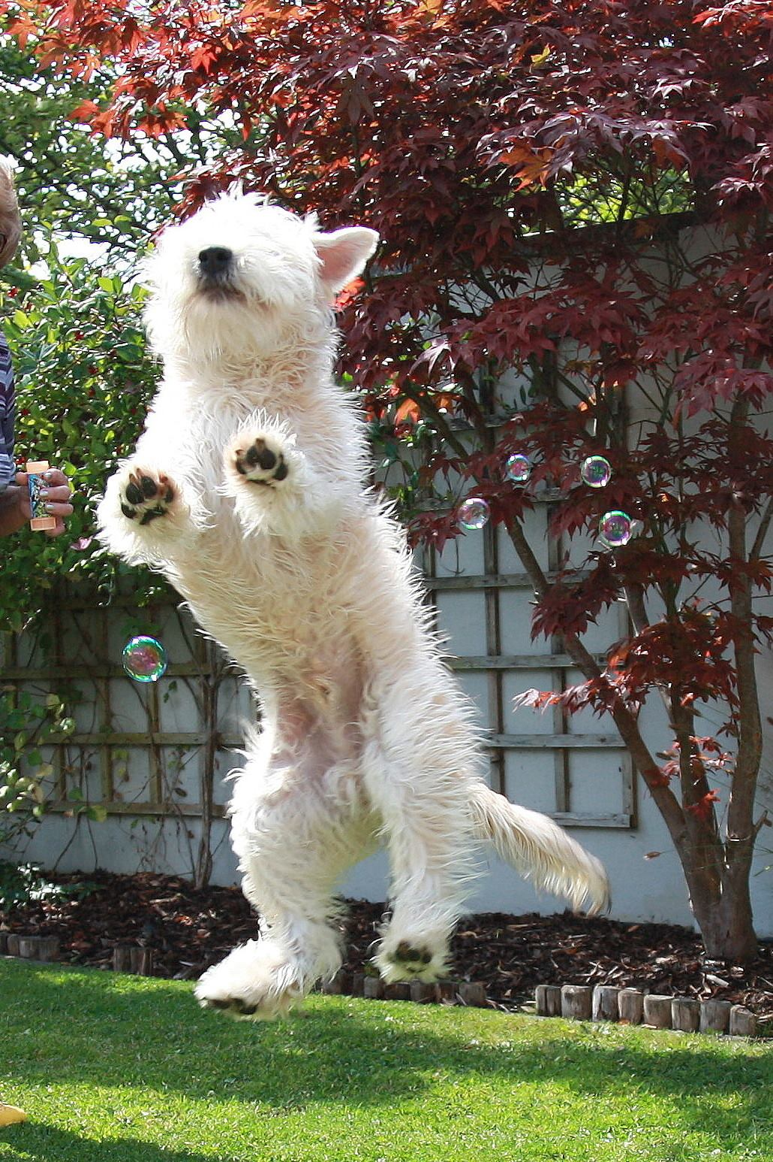
Irish Soft Coated Wheaten Terrier

Slide 2
Type

Slide 3
Breed Type in Breeders Group Overall appearance and ring presence An Irish Soft Coated Wheaten Terrier (ISCWT) should display terrier attitude be able to stand of its own accord showing with its head held high and body giving an impression of strength. Although the ISCWT should not be aggressive they should be able to display a high level of confidence in the show ring. The tail should be held upright or slightly forward but never tipping the back.

Slide 4
General Appearance
A hardy, active, short coupled dog, well built, giving the idea of strength. Not too leggy nor too low to the ground.

Slide 5
Characteristics
Spirited and Game.

Slide 6
Temperament
Good tempered. Most affectionate and loyal to his owners. Most intelligent. A trusty, faithful friend, defensive without aggression.

Slide 7
Head and Skull
Head long, in good proportion to the body. Skull flat and clean between the ears not too wide. Defined stop. Jaws strong and punishing. Foreface not longer than skull. Hair the same colour as on the body. Cheek bones not prominent. Head in general powerful without being coarse.
Expression
The ISCWT should have a strong Terrier expression showing a keen interest in their surroundings.

Slide 8
Nose
Black and well developed.

Slide 9
Eyes
Dark, Dark Hazel, not too large, not prominent, well placed.

Slide 10
Ears
Small to medium, carried in front, level with Skull. Dark Shading at base of ear allowed and not uncommon, accompanied by a light wheaten coloured overlay. ‘Rose’ or ‘flying’ ears are objectionable.
Ears that are medium in size that have the fold level with the skull and are carried close to the side of the head with the tips pointing to the corner of the eye. The colour of the head and ears should be a clear wheaten colour. However red shading on the base of the ears is allowed accompanied by a light wheaten overlay.

Slide 11
Too Big with Grey
A small ear carried high on head gives an incorrect “cute” expression and low dropped ears make the expression too soft. Ear colours that vary from this such as black blue or grey do not give a correct impression of the breed.

Slide 12
Mouth
Teeth large, regular scissors or level bite, neither undershot nor overshot.
Scissors bite

Slide 13
Neck
Moderately long and strong but not throaty.

Slide 14
Body
Compact and not long, with powerful short loins. Level top line. Thighs strong and muscular.
An ISCWT should be at all times moderate and no part of them should be exaggerated. They should be of medium height and not overly big.

Slide 15
How to Measure an ISCWT
They should be the same length from their withers to their tail as they are high. The height to length ratio is not to exceed 19 inches.

Slide 16
Hindquarters
Well developed with powerful muscle. Stifles well bent. Hocks well let down, turned neither in nor out.
Feet small not spreading. Toenails preferably black but varying colours allowed

Slide 17
Tail
Well set, not too thick. Carried gaily.

Slide 18
Gait
Straight action fore and aft, going and coming. Elbows tucked in. Side view: free, light, co- ordinated movement.

Slide 19
Movement
They should be well muscled, be well boned and active. Their movement should be an easy action that covers as much ground as possible with the least amount of effort whilst maintaining its profile.

Slide 20
Coat Hair
A single coated dog. Texture soft and silky to feel and not harsh. Young dogs are excluded from this. Trimming is permitted.
Incorrect Heavy
Correct Coat

Slide 21
Pups
Are seldom born with the correct colour or texture of coat. They come Reddish, greyish and sometimes clear wheaten. The masks are generally black sometimes there is a black streak down the centre back or black tips to the body coat. These dark markings clear away with maturity.
6 Month Old English
6 Month Old Correct Coat

Slide 22
Puppies & Mother
As Puppies ISCWT’s can have differing coat texture and colours. This varies from little or no coat to a more abundant single coat. Their colour can be fawn, golden or red, with or without grey tips to the coat and can be harsh or soft in texture. Only Puppies are permitted to have black shading on their beard.

Slide 23
Incorrect Type of Coat
Heavy Coat
Too Curly

Slide 24
Colour
Any shade from light wheaten to a golden reddish hue.
There are differing levels of maturity in ISCWT’s and so the coat texture can vary slightly until after at least 2½ yrs. No matter what stage of maturity an ISCWT should always have a single coat.

Slide 25
Texture
Adults dogs can either have a wavy or a loosely curled coat with a sheen of silk. Dogs that have their coats fluffed out or overly trimmed like a Kerry Blue do not depict the essence of the breed. An ISCWT coat should be abundant but not overly so i.e. the coat should be at least 3 inches long. The coat can be cut close around the head and neck and the body hair tidied to the outline of the dog.
An ISCWT’s Coat should have a sheen or gleam radiating from it under natural light.

Slide 26
Heavy Undesirable Coat

Slide 27
Weight
Dogs 35 – 40 lb (15.75 – 18 kg). Bitches somewhat less.

Slide 28
Review
A typical finished adult ISCWT should have an assertive upstanding and independent posture (not stacked). It should have great ring presence with a determined expression and be clearly coloured with obvious sheen in its coat.
As these are the features and characteristics that make the breed unique a lot of importance should be placed on them and though the entire standard is important extra credit should be given to dogs who posses these qualities.

